Slide 1
Standards of practice
LHSC EMERGENCY PROGRAM
2014

Slide 2
WHY?

Slide 3
A significant variation in practice.

Slide 4
OBJECTIVES
Minimal Nursing Assessment Frequency
Scope of Nursing Assessments – ED vs. Admitted pt.
Frequency of vital signs – Pre & Post MD assessment
IV Site Assessments and Frequency
Fluid Balance Assessment and Frequency
Turning/Repositioning
Transporting Patients out of Emerg.
Glasgow Coma Scale (GCS) & Pupillary Response Assessment
CSM Assessments
Miscellaneous Assessments

Slide 5
Environment
Comfort & Safety

Slide 6
All patients must have area requiring assessment
exposed (i.e. pt. with dislocated shoulder must have
gown on with bra/tank/t-shirt off;
pt. with abd. pain: everything off but underwear)
Ensure patient’s comfort: remove shoes

Slide 7
Patient Comfort
Ensure bedside is neat
Ensure sheets are neat
Ensure patient is covered appropriately
Remove EMS sheets
Ensure bed in low position and locked

Slide 8
MINIMAL NURSING ASSESSMENT FREQUENCY
LHSC - Adult Emergency

Slide 9
Nursing assessment/documentation will be performed:
Upon assuming care of the pt.
ex: new pt. to the Pod, at shift change.
(Not applicable for covering breaks)

Slide 10
With all nursing interventions.
ex: Blood work drawn & sent, transferred to BR with 2 person assist, turned r/t skin integrity.

Slide 11
With change in pt. general condition.
ex: Marked change in vitals, marked deterioration, marked improvement in comfort level.

Slide 12
SCOPE OF NURSING ASSESSMENTS
All assessments must be documented.

Slide 13
The Emergency Patient
1) ABCD on all patients by primary nurse.
Pt. to Pod A per wheelchair, talking and breathing spontaneously, pink and alert.
Targeted assessment r/t complaint.
(Use 3 system approach)
Notes:
The aim of the ABCD documentation is to give a good history about the pt’s condition on arrival to the Pod.

Slide 14
3 SYSTEM APPROACH
Reason for visit: Chest pain
3 Possible systems that may be responsible for CP
Cardiac OPQRST Doesn’t change Pressure, Stabbing Radiation to arms? Pain Score Constant? Diaphoresis? Nausea/vomiting? | Gastro OPQRST Worse with food Burning Possible radiation to back Pain Score Wave like pain Associated with food? Use of antacid? Effective? White knight effective? | Musculo/Skeletal OPQRST Worse with movement Sharp, Pulling No radiation Pain Score Pain settled at rest Recent work outs? Recent trauma? Shoveling?
Notes:
OPQRST – Onset, Provoking factors, Quality, Radiation, Severity, Timing
There are more than 3 systems responsible for Chest pain, just asking people to give it thought. Sometimes three systems doesn’t work. Ex: Ear infection. Targeted ear pain assessment is necessary but possibly also a neuro eval. Eye injury. Targeted eye pain assessment is necessary, possibly neuro also depending on mechanism. Pupil response at minimum.

Slide 15
The Admitted Patient
Must visualize and check in with the patient within 30 minutes of shift change.
Ex: Received on shift change, pt. in bed resting.
General head to toe assessment including skin integrity, respiratory assessment and last bowel movement. Doesn't have to be immediately upon shift change. This is done once per shift ☺
Done at shift change, prior to handover to another team, when status changes.

Slide 16
Example:
Received post shift change. Pt. resting in bed comfortably, talking and breathing spontaneously. Lung fields clear bilaterally. Pt. pale but skin warm & dry. Remains confused to place & time but oriented to person. Using urinal appropriately. Repositioning self in bed. Family at bedside and reports pt.’s last BM at home prior to coming into hospital. Vitals stable. Awaiting inpatient bed.
Notes:
Start broad with ABCD assessment and then become more targeted.

Slide 17
Frequency of Vital Signs

Slide 18
Prior to MD Assessment
CTAS 1 q 15 minute
CTAS 2 q 60 min
CTAS 3 q 60 min
CTAS 4 q 4 h
CTAS 5 q 4h
Notes:
These are ideal targets

Slide 19
Post MD Assessment
Minimum q4h VS on stable pts. for ED patients
For admitted patients: as ordered & prn.
If not ordered: q4h and prn
Vital signs are reassessed related to previous vital signs. Vitals outside of normal range must be reassessed q 30 min unless RN can qualify why VS are okay to be outside normal range.

Slide 20
Pt. BP 96/54 but states in normal range for her.
Vital Signs (Normal Signs vs. Outside of Range)
HR | 60-100 | (Normal Range)
BP | 100/60 - 140/90 | (Normal Range)
RR | 12-20 | (Normal Range)
Temp | 36-37.5 | (Normal Range)
SpO2 | Under 92% requires q 30min assessments. | Unless pt. known to be CO2 retainer
Pain | 8-10/10 requires q 30min assessments. | Unless chronic, eating timbits, drinking coffee

Slide 21
VITAL SIGNS – STABLE ADMITTED MH PATIENTS
As ordered by admitting psychiatrist.
Vital signs at the beginning of each shift minimally.
If the patient become mentally unstable, refer to post MD assessment of vital signs.

Slide 22
Vitals Signs With Product Administration
* Please refer to blood transfusion manual.

Slide 23
IV SITE ASSESSMENT

Slide 24
IV SITE ASSESSMENT
Site checks q4h continuous.
Site checks at the start and end of each shift
Site check after initiation of each medication and increase frequency of site checks with certain medications. (See PDAM re: risk for extravasation)
Central Line checks q4h
Arterial Line checks q4h

Slide 25
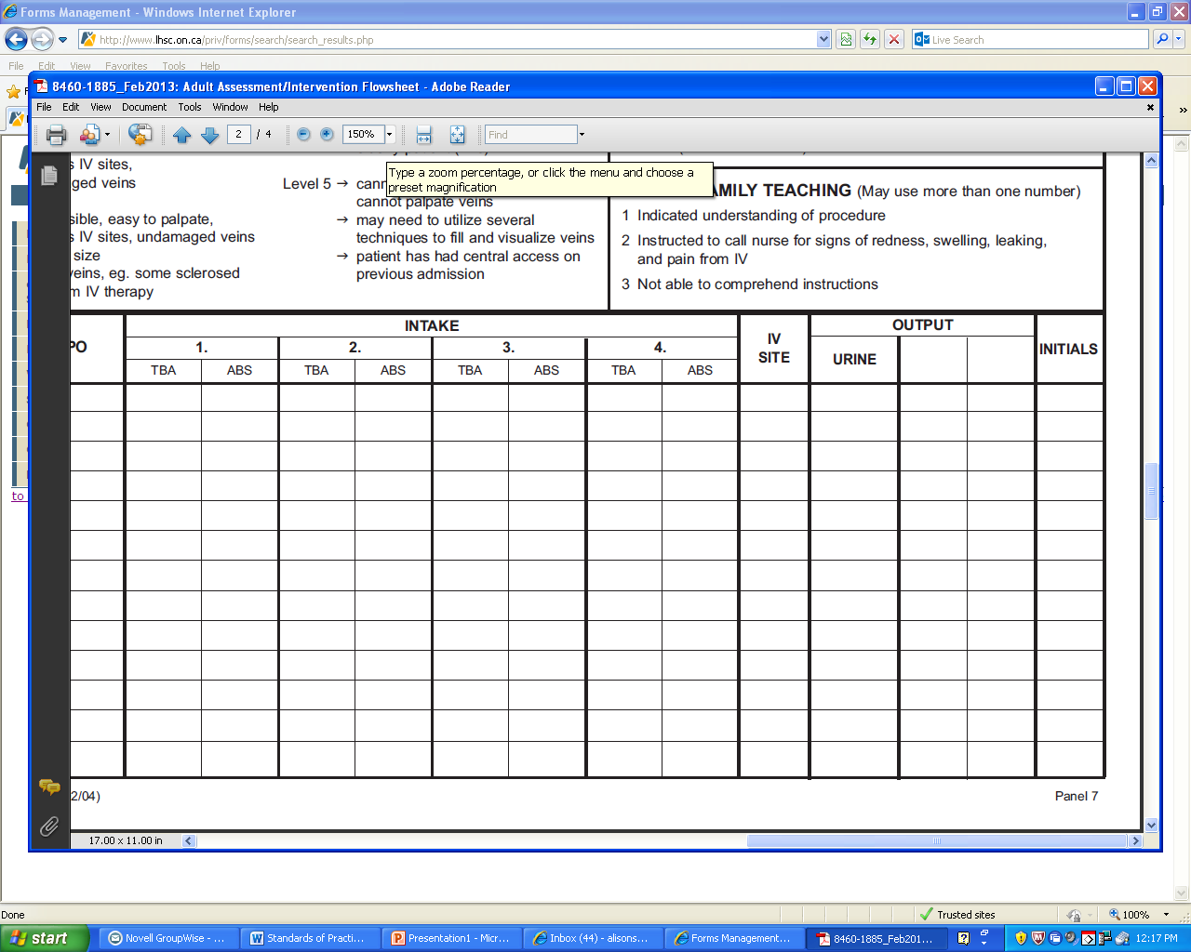
IV SITE ASSESSMENT
Check mark for every line (ex: if pt. has 4 lines, 4 check marks would be present) = Site assessed to be in situ without signs of inflammation or extravasation.
Narrative entry required if site abnormal in anyway.

Slide 26
FLUID balance

Slide 27
Minimal assessment of hydration status in patients who have:
Continuous infusions (Including Blood Admin.)- minimally at the end of every shift
Volume altering medications - ie: Diuretics
CBI
NG
As you hang bags & as patient has output (vomit, urine, NG fluids), we must document.
Balance at the end of shift and/or transfer of care to floor.
Notes:
Documentation of fluid balance!

Slide 28
Turning & Positioning

Slide 29
Turning & Positioning
Patients with impaired mobility: Reposition q 4-6 hrs or more often if skin integrity is at risk.
Assess skin integrity over pressure points and treat/prevent breakdown.
Work with charge nurse to prioritize a high risk patient. (Quad/ Bariatric)
Ambulate if orders in place - access PT/OT/EDT
Notes:
Remember to document all nursing interventions!

Slide 30
Transporting Patients out of ED

Slide 31
RN's accompanies patient off unit:
All monitored pts.
Telemetry (require MD to override order).
Receiving oxygen at or above 50% (RT/RN).
All ICU/Level II units (Trauma Obs./Neuro Obs.).
Pts. with unstable hypotension
Care needs to be taken when transporting pts. with acute altered LOC from baseline.
Unstable/at risk airways (Intubated/BiPap).
Any pt. receiving blood transfusion should go to floor with the RN.
Care needs to be taken when transporting pts. who are actively SOB or have CP.
C-Spine protection – As per MD order
Notes:
Don’t send pt’s to xray with chest pain unless they have a negative 12 lead and negative trops or at discretion of the MD.
If acutely SOB, get portable chest.

Slide 32
Glasgow Coma Scale (GCS) & Pupillary Response:

Slide 33
Glasgow Coma Scale (GCS) & Pupillary Response:
Initiate with patient who have altered LOC.
Overdoses
Headaches
Head/Facial Traumas
Visual disturbances
Then frequency of assessment tied to vital signs - Minimum q4h -
Notes:
Overdoses – Could come totally alert and oriented but then become obtunded. Must document initial GCS even if totally normal.

Slide 34
Circulation, Sensation, Mobility (CSM)

Slide 35
CSM
To be completed for pts. with limb injuries and/or neurovascular compromise.
Minimum q4h (with vitals).

Slide 36
FALLS ASSESSMENT

Slide 37
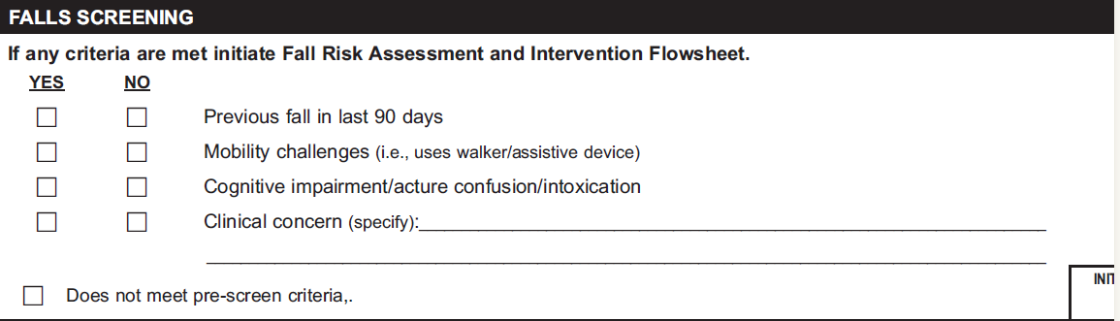
FALLS RISK ASSESSEMENT
Must be done on every pt.
Selecting all “No” = No falls risk assessment needed
Selecting one “Yes” = Full Falls Risk Assessment needed.

Slide 38
Miscellaneous

Slide 39
Miscellaneous
Visual Acuity
- Must be documented (corrected) on every eye pt.

